Slide 1
TITLE: ABOVEGROUND BIOMASS CHANGE AND TERRESTRIAL CARBON STOCK IN THE FOREST AND WOODLAND AREAS OF SOUTHWESTERN NIGERIA
DEFENSE OF THESIS FOR THE AWARD OF DOCTOR OF PHILOSOPHY IN REMOTE SENSING, DEPARTMENT OF GEOGRAPHY, SCHOOL OF POSTGRADUATE STUDIES, UNIVERSITY OF LAGOS, NIGERIA.
UDOFIA, Samuel Kevin
(060906078)
Supervisors:
Dr. Mayowa Fasona (Asso. Prof.)
Dr. Shakirudeen Odunuga (Asso. Prof.)

Slide 2
Background of the Study
Vegetation consists of all plant life on the earth’s surface and some environmental factors determine their floristic appearance.
The floristic composition of plants determines the biomass of the forest.
Therefore, forests play a significant role in maintaining and balancing gases such as CO₂ in the atmosphere.
Human and natural drivers of deforestation and forest degradation have caused the unbalancing of terrestrial carbon sinks.
The 1.394 million hectares of Nigerian forest are rapidly decreasing at an estimated rate of 110,000 ha per annum.

Slide 3
Statement of Problem
Both forest degradation and deforestation are caused by anthropogenic processes.
There are increases in carbon losses from forests, increasing the risk of climate change impacts such as flooding, erosion, and heat waves and loss of lives and property in southwest Nigeria.
There is a knowledge gap on the relationship between deforestation, biomass changes, and carbon fluxes.
The country lacks baseline data on carbon stock in southwest Nigeria.
The gap in literature reveals no synoptic approach to land use/land cover, biomass, and carbon stock studies in Southwest Nigeria.

Slide 4
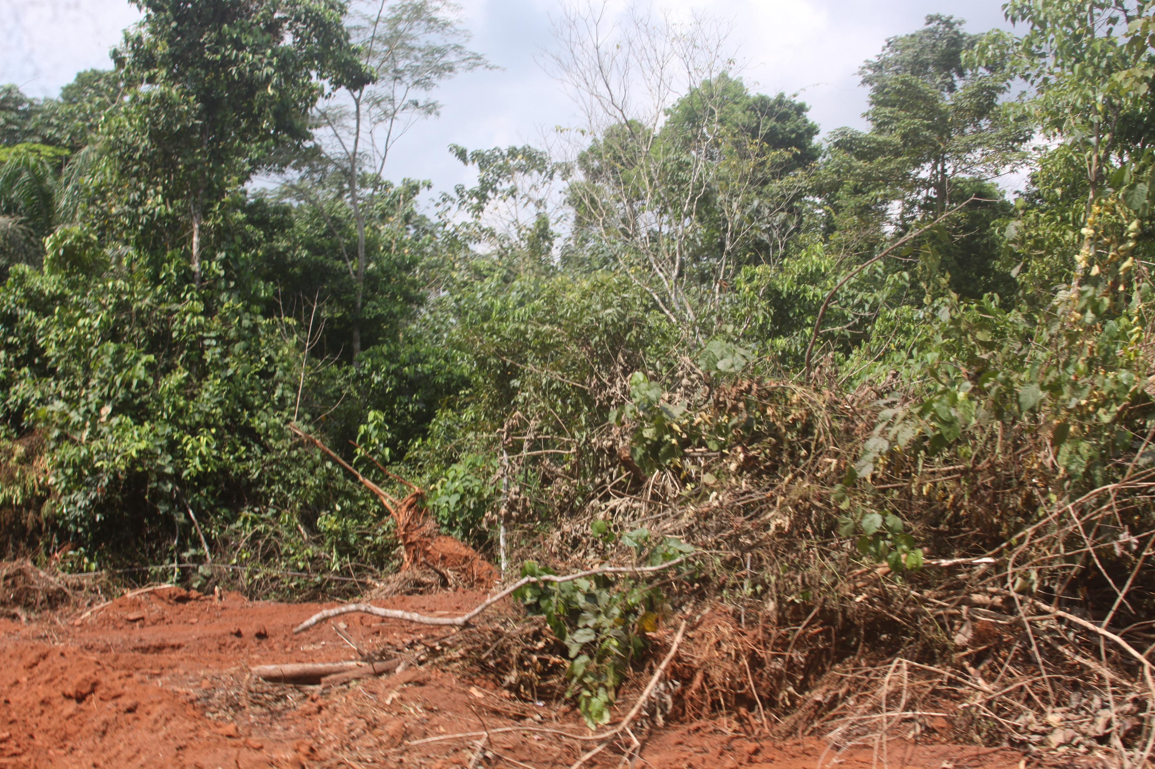
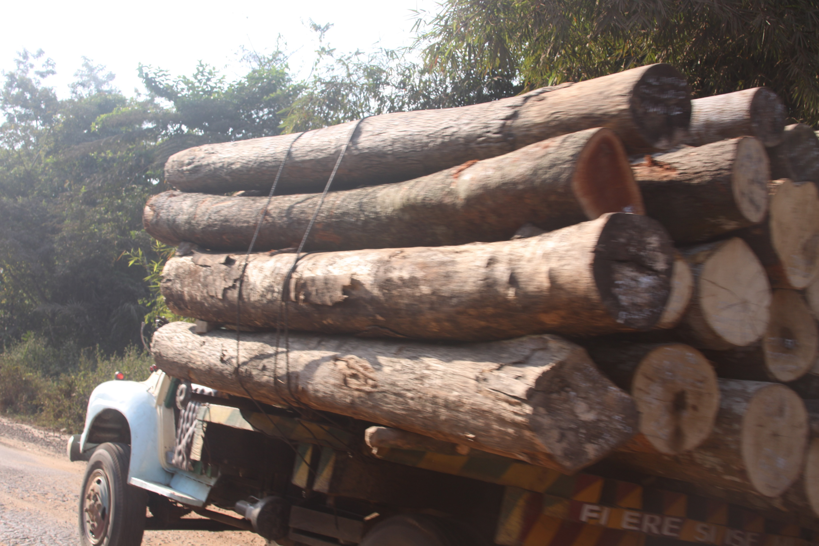
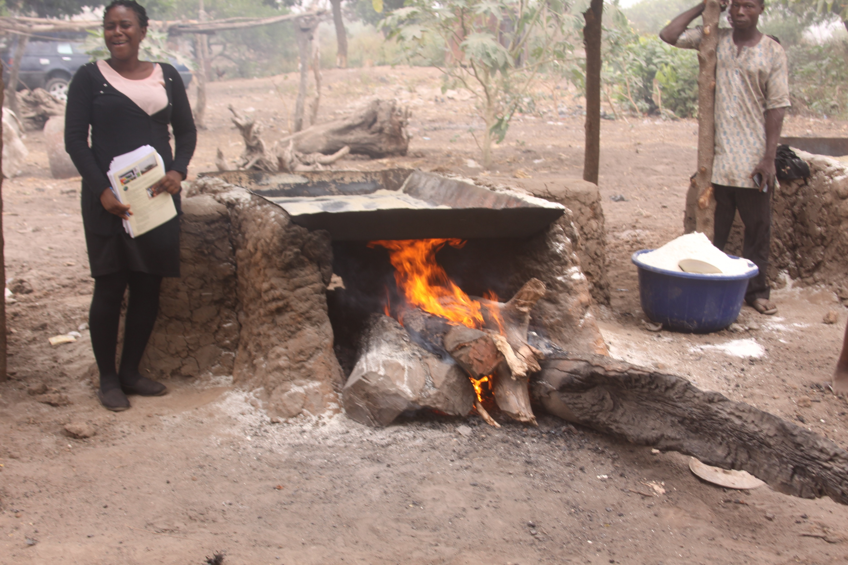
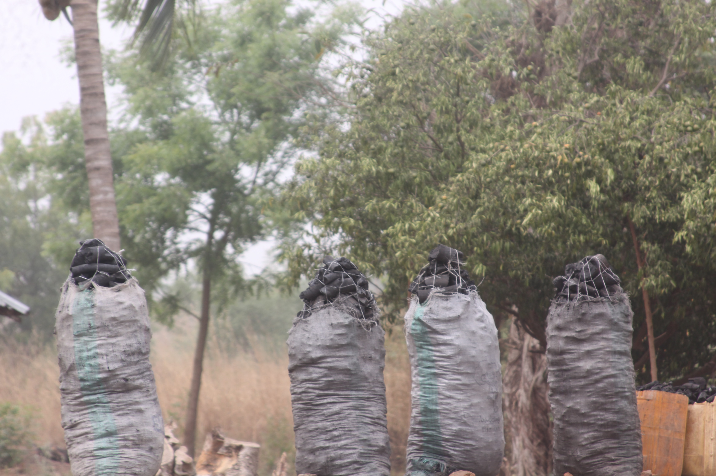
B
A
Environmental Issues leading to degradation deforestation and forest degradation
C
D

Slide 5
Aim and Objectives
This research investigates changes in the aboveground biomass and the carbon stock in forest and woodland areas of Southwest Nigeria between 1986 and 2016.
The Specific Objectives are to;
Analyze the trend and pattern in forest and woodland conversion from 1986 to 2016,
Examine the trend and pattern in aboveground biomass induced by vegetal conversion and degradation,
Estimate the carbon stock in the forest and woodland between the two epochs, 1986 to 2016,
Predict the changes in future carbon fluxes up to 2066,

Slide 6
Research Questions
What are the spatial and temporal trends of Forest and woodland conversion from 1986 to 2016 in the study area?
How has deforestation and woodland degradation contributed to aboveground biomass change spatially and temporally in the study area between 1986 and 2016?
What is the extent of carbon stock generated by biomass change in the period under investigation?
What is the likely pattern of carbon fluxes from future land-use changes in the study area?

Slide 7
Significance of the Study
This research delivers direct benefits to the communities, stakeholders, and policymakers intricately linked to the ecosystems of SW Nigeria.
This information supports policymakers at both regional and national levels in designing initiatives for forest conservation, sustainable land use, and carbon sequestration.
It aids in making well-informed decisions about forest management strategies, carbon pricing mechanisms, and climate change mitigation efforts in Southwest Nigeria.
This study will support initiatives like REDD+ (Reducing Emissions from Deforestation and Forest Degradation), which is aimed to mitigate climate change by preserving forests.
It equips researchers and environmentalists with the foresight needed to develop proactive climate change mitigation strategies, strengthening resilience against anticipated climate change impacts in the region.
It serves as a cornerstone for informed decision-making and proactive measures, safeguarding the ecosystems and the well-being of SW Nigeria while contributing to global effort in climate change mitigation and environmental conservation

Slide 8
Scope and Delimitation of the Study
The study only covered Ekiti, Ogun, Ondo, Osun, and Oyo states.
The study period for the research was only 1986 to 2016.
The study focuses on carbon emissions from forest degradation and deforestation in the woodland and forest areas.
Field verification and field measurement in selected sampling locations for the purpose of validating the remote sensing result.
Therefore, the results were based on interpreted proxies from satellite imageries and limited field measurements.
The study was limited to Above Ground Biomass and its associated carbon pools because of its importance to forest and woodlands carbon fluxes.

Slide 9
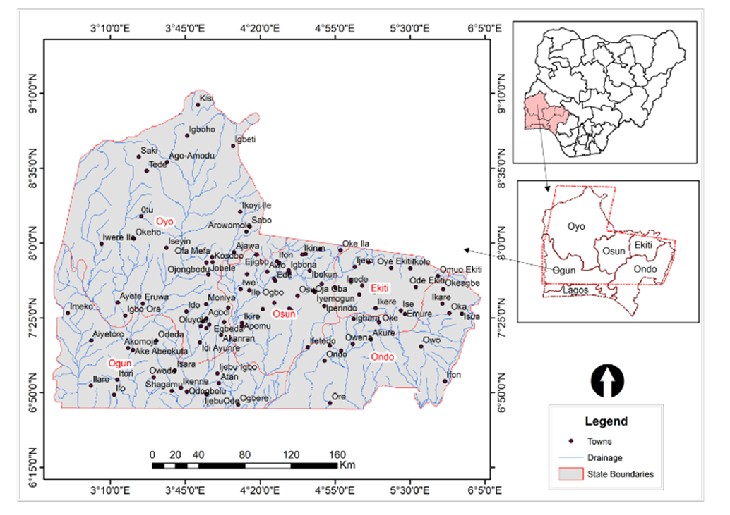
Study Area
This research covers Ekiti, Ogun, Ondo, Osun and Oyo States of Nigeria.
It is defined by longitude 3⁰ 05¹ to 5⁰ 25¹East and Latitude 6⁰ 05¹N to 9⁰ 10¹North.
It covers approximately 6,364,030 ha (63,641km²) in the areal extent.
It has the highest number of forest reserves in Nigeria.

Slide 10
Literature Review and Conceptual Framework
Literature Review
Global forest and woodland deforestation and degradation and Carbon emission estimation.
Tropical Savannah and Forest ecosystems.
Remote Sensing and Land use Classification.
Remote Sensing for Carbon and Biomass Estimation.
Modelling Present and Future Biomass and Carbon.
Forest management policies
Forest Area, Governance, and Exploitation in Nigeria
Effect of Forest Decision Making and the Rights of the Indigenous People

Slide 11
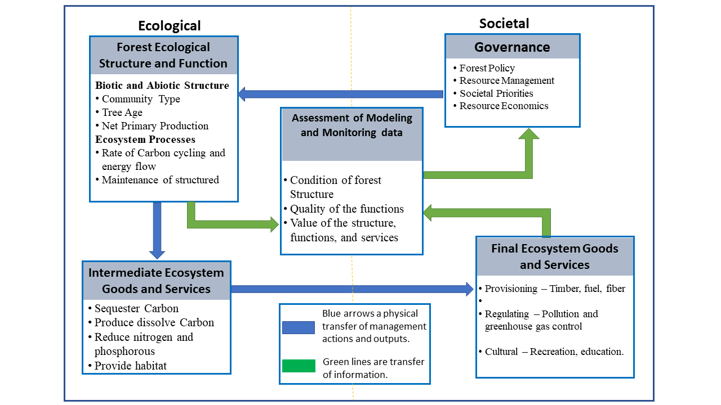
Conceptual Framework
Carbon Cycle
Social-Ecological Systems Theory

Slide 12
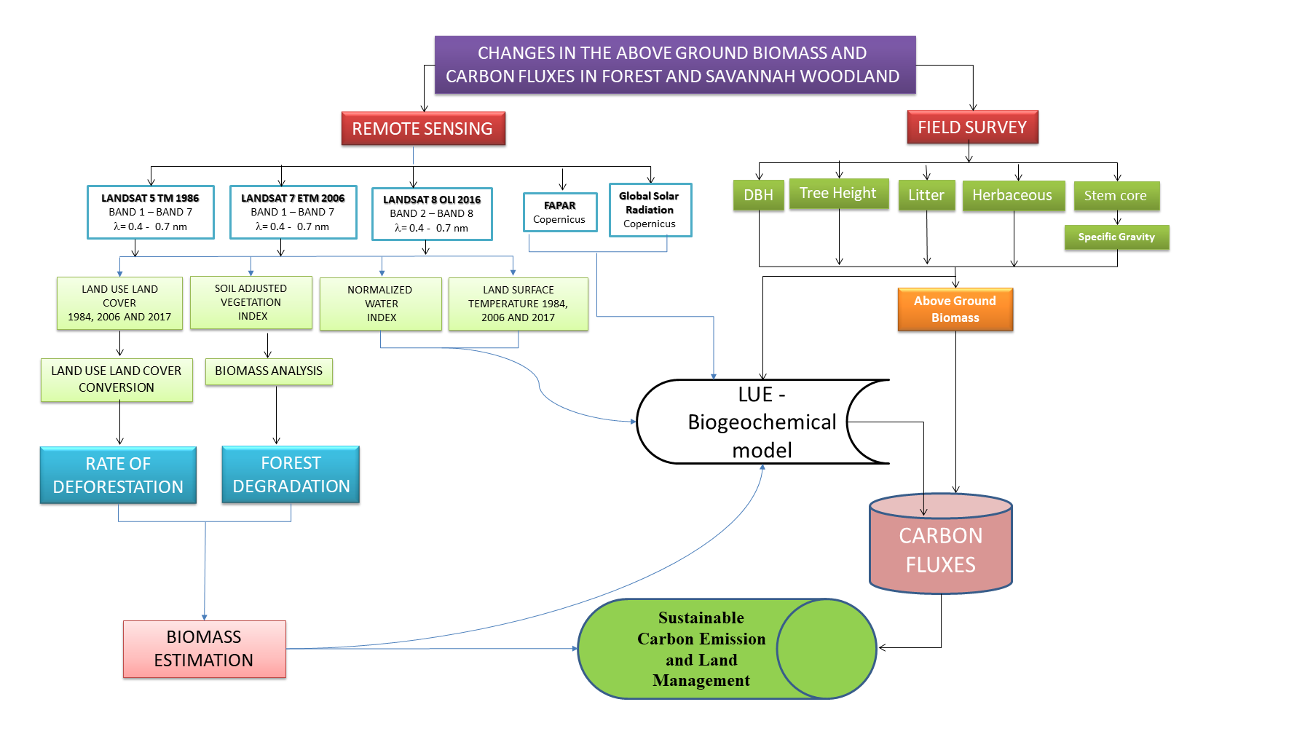
Research Methodology
Methodological framework

Slide 13
Research Methodology cont’d
OBJECTIVE | DATA | METHOD OF ANALYSIS | Expected Outcome
Objective 1 | Landsat 5 TM - 1986 Landsat 7 ETM - 2006 Landsat 8 OLI - 2016 | Unsupervised and Supervised classification. Land use and Land cover Change Analysis State Transition Simulation Model (STSim) | Landuse /Landcover Map Rate and Magnitude of landuse change Projected Landuse land cover for 2066
Objective 2 | Landsat 5 TM - 1986 Landsat 7 ETM - 2006 Landsat 8 OLI – 2016 Fraction of Absorbed Photosynthetically Active Radiation (FAPAR) | Soil Adjusted Vegetation Index Model Estimation of PAR and FAPAR | Above Ground Biomass distribution
Objective 3 | Field Data Sampling Derived data from Biomass estimation | Carbon Fluxes Estimation (CASA Model) Field estimated Carbon in Land use / Land cover area | Carbon fluxes distribution
Objective 4 | Field Data Sampling Derived data from Biomass estimation | State Transition Simulation Model (STSim) | 2066 Carbon stock distribution

Slide 14
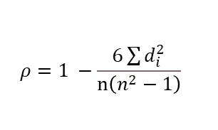
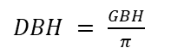
Field Data Sampling for Remote Sensing Validation
Research Methodology cont’d
S/N | Land cover | Community | State
1 | Savannah woodland | Erifun-Ilaro | Ogun
2 | Savannah woodland | Awo | Osun
3 | Natural Forest | Orile Owu | Osun
4 | Natural Forest | Okeluse | Ondo
5 | Cocoa Plantation | Igbara Oke | Ekiti
6 | Teak Plantation | J4 Junction | Ogun
7 | Savanna woodland | Okeagbe-Akoko | Ondo
8 | Natural Forest | Erin Camp | Ogun
9 | Savannah Woodland | Ottu | Oyo
10 | Natural Forest | Shasha | Osun
11 | Cocoa Plantation | Ibokun | Osun
12 | Grassland | Igbetti | Oyo
13 | Oil Palm | Ijebu Igbo | Ogun
14 | Woodland | Igboho | Oyo
15 | Gmelina | Odigbo | Ogun
16 | Savanna | Odo Ayedun | Ekiti
17 | Savanna woodland | Ikoyi-Ile | Oyo
18 | Gmealina/Teak | Ikeji | Osun
Field Estimation of Above Ground Biomass and carbon
AGB Biomass (kg) = exp (-2.29 + 0.17 (InD)2 + 0.66 In (D2H +0.13In(p)) (Djomo et al., 2011)
Where, D is the diameter at breast height, ρ is the specific gravity, and H is the height of the individual tree species.
$DBH = \frac{GBH}{π}$
Where: GBH = Girth at Breast Height and π = 22/7
validate the carbon result from remote sensing
$$ρ=1 −\frac{6\sum{d_{i}^{2}}}{n\left(n^{2}−1\right)}$$
spearman correlation was used to analyse the degree of relationship between remote sensing and field measured carbon

Slide 15
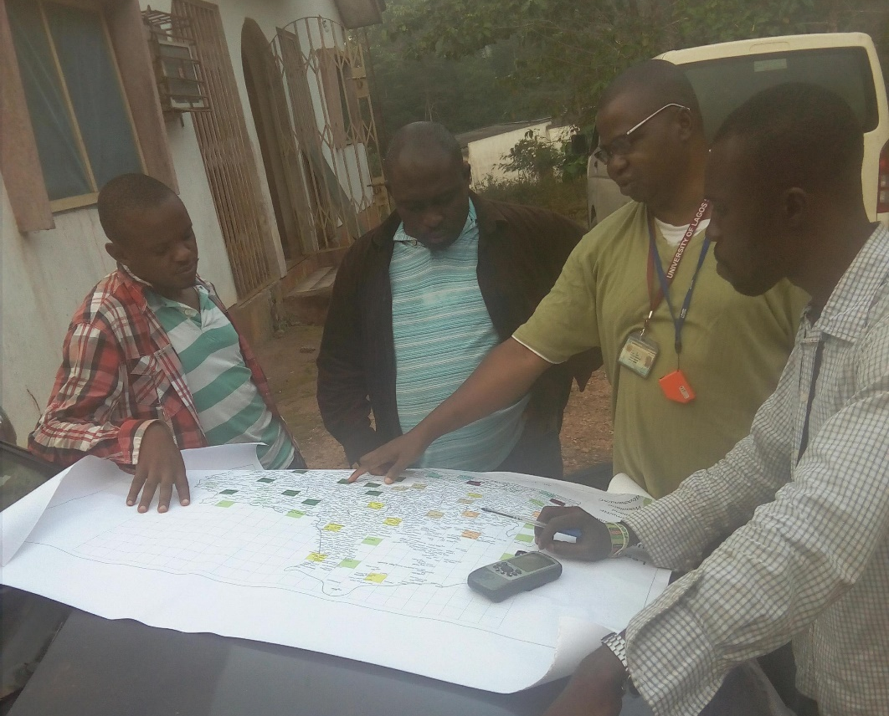
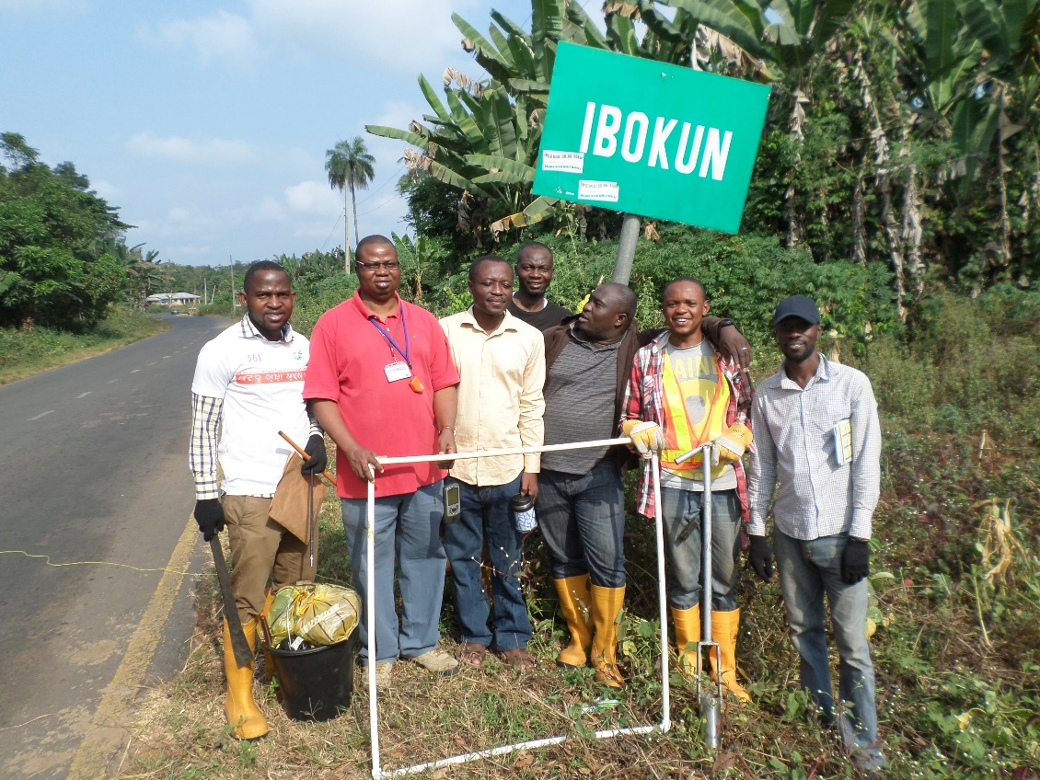
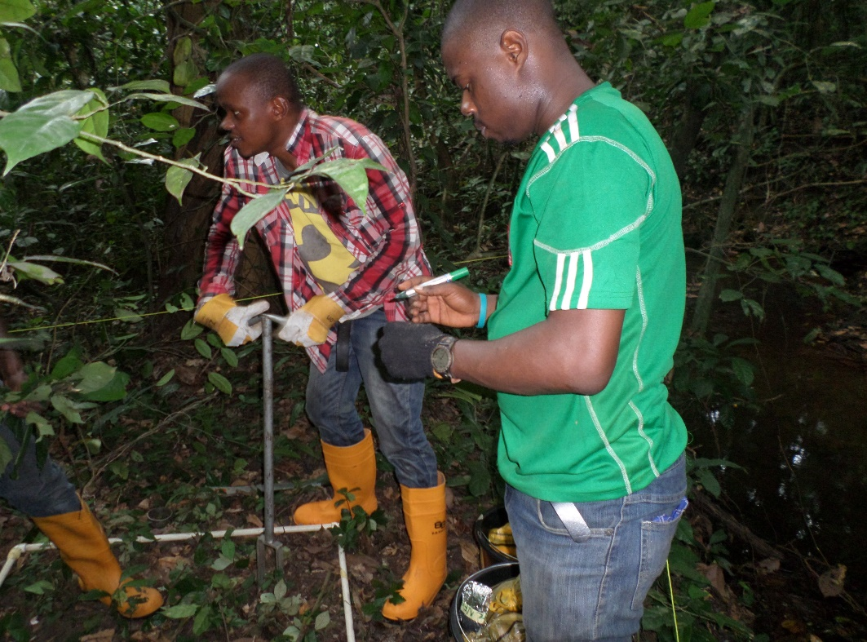
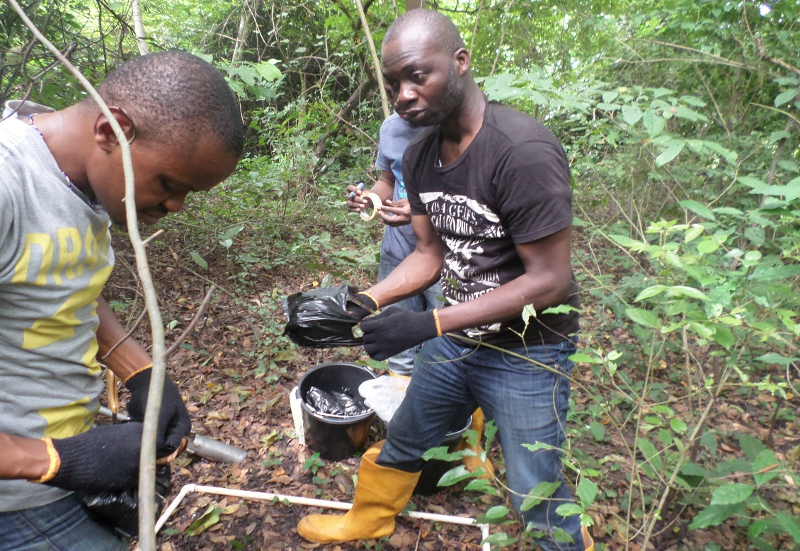
Fieldwork Activities

Slide 16
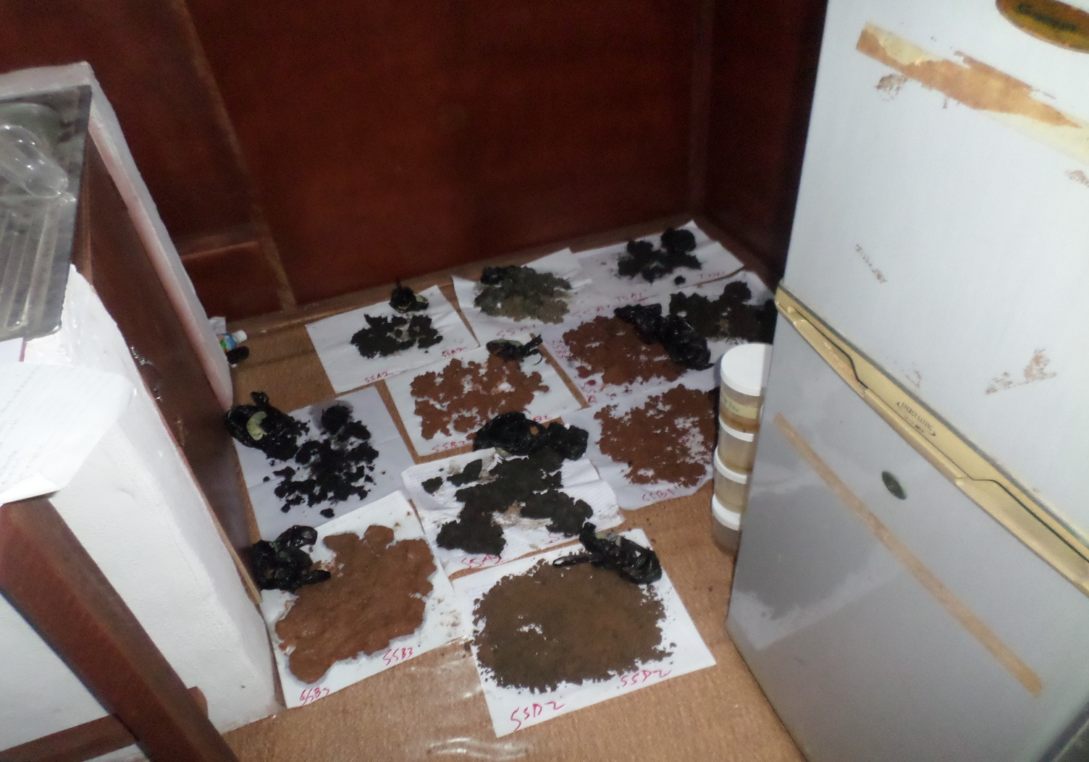
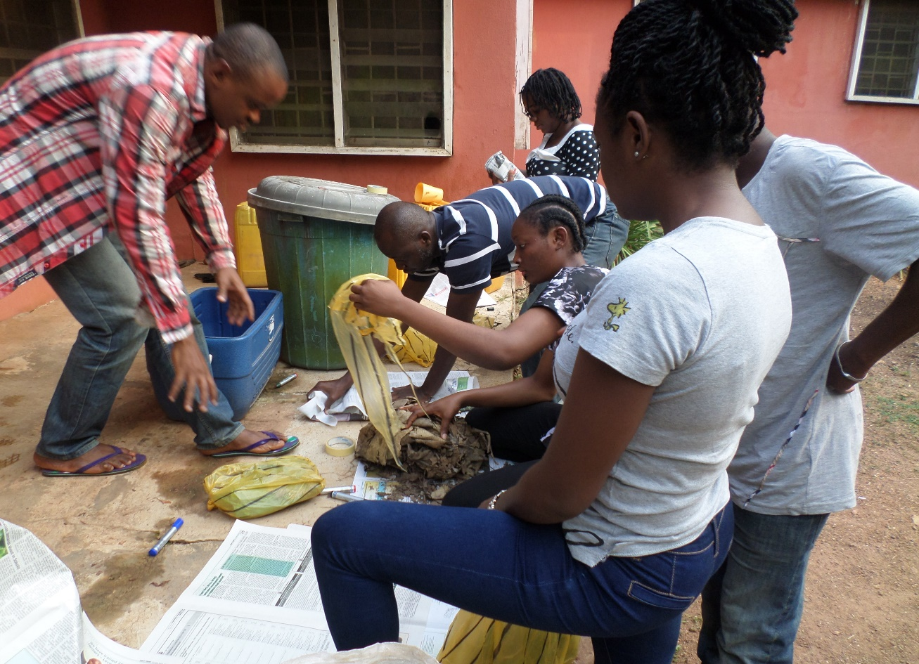
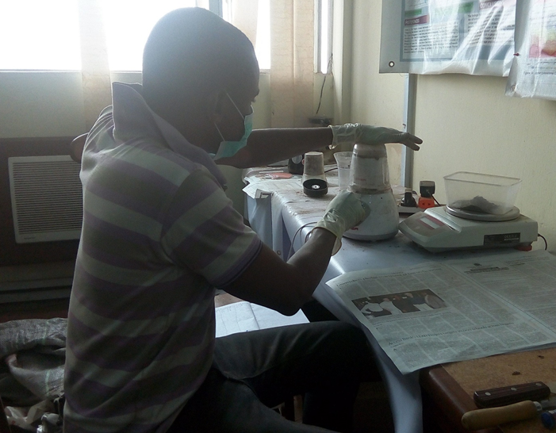
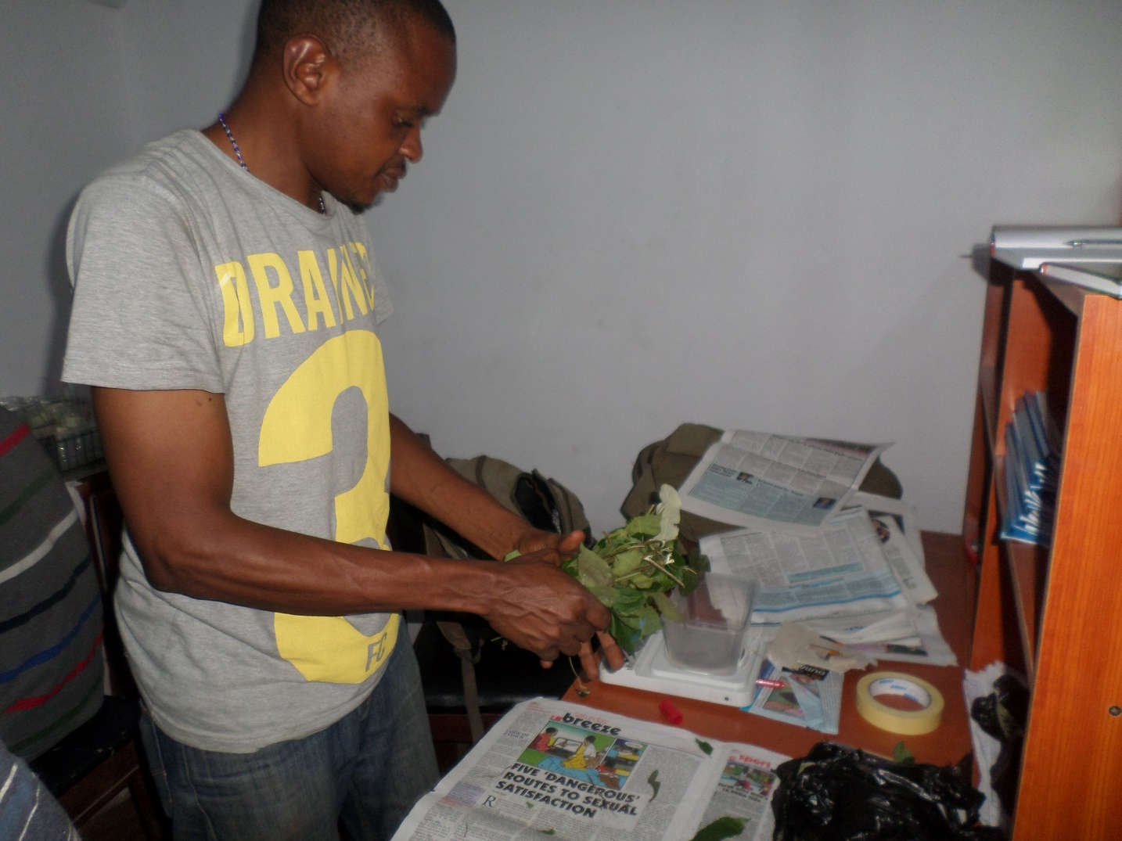
Samples Processing

Slide 17
Results and Discussion
Objective 1 - Static Landuse and Landcover 1986 to 2016

Slide 18
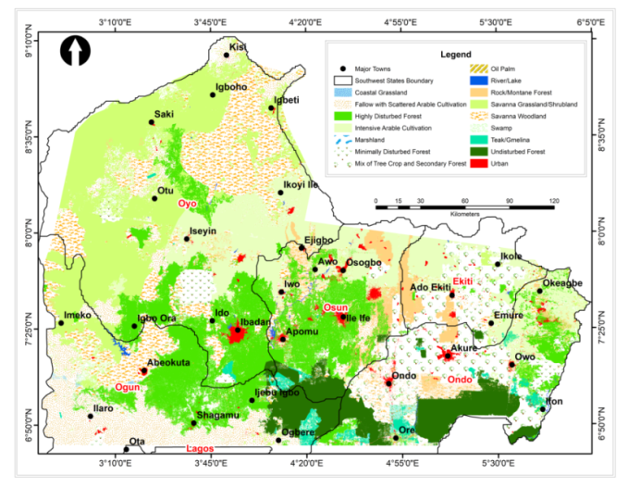
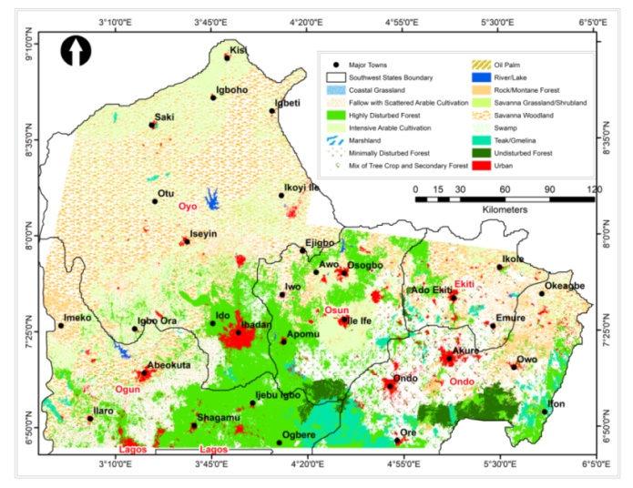
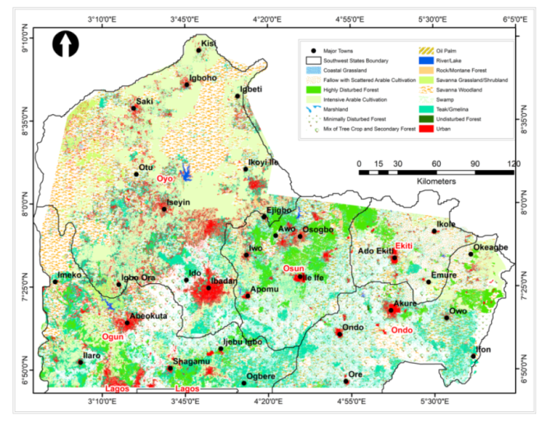
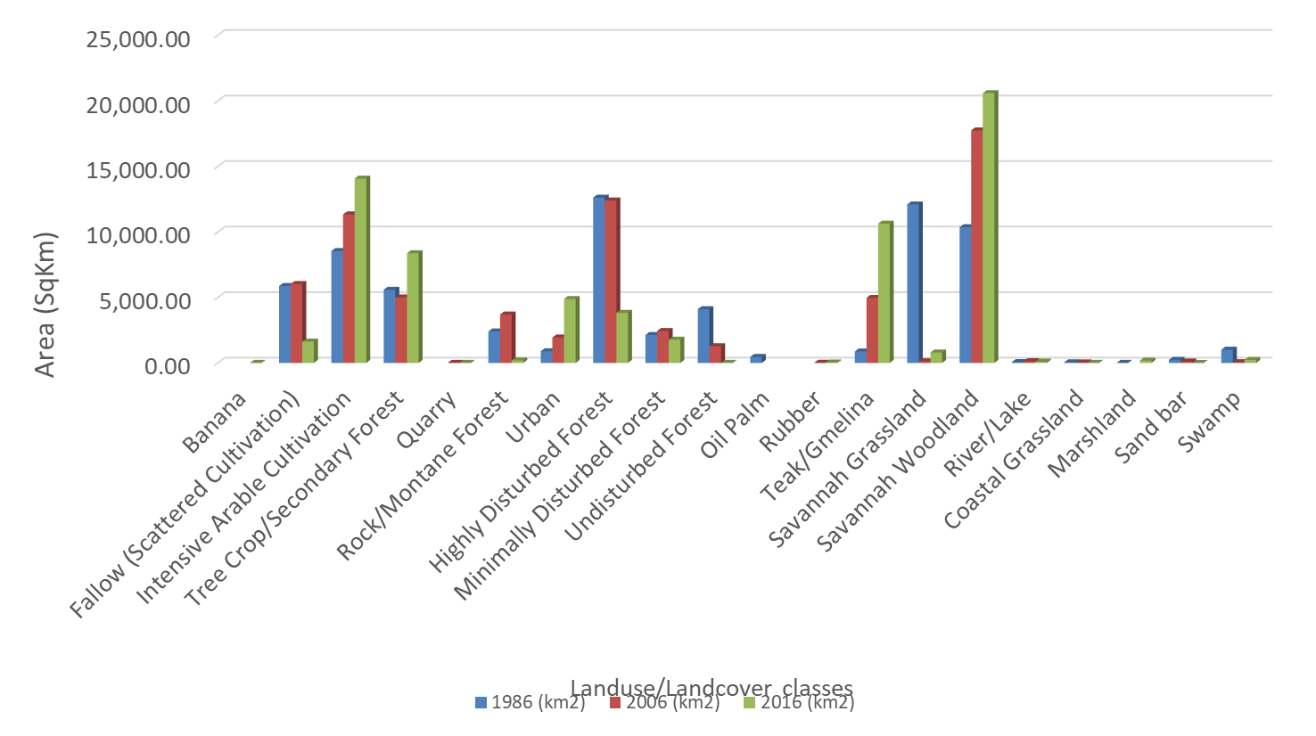
Land use/landcover change pattern across the study area
1986
2006
2016

Slide 19
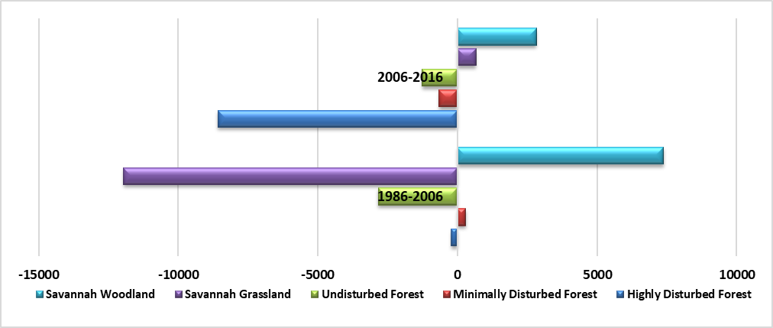
Savannah and Forest Loss/gain Pattern

Slide 20
OBJECTIVE 2 – Trends and Pattern of Above ground Biomass Change across the land use

Slide 21
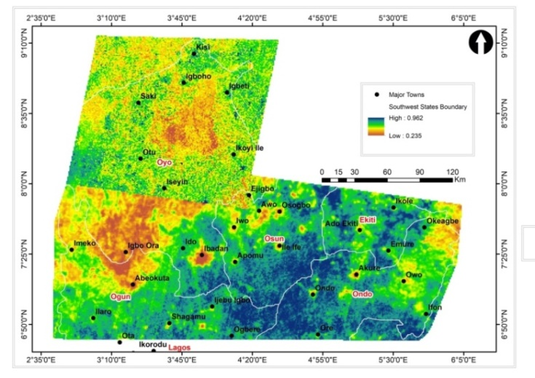
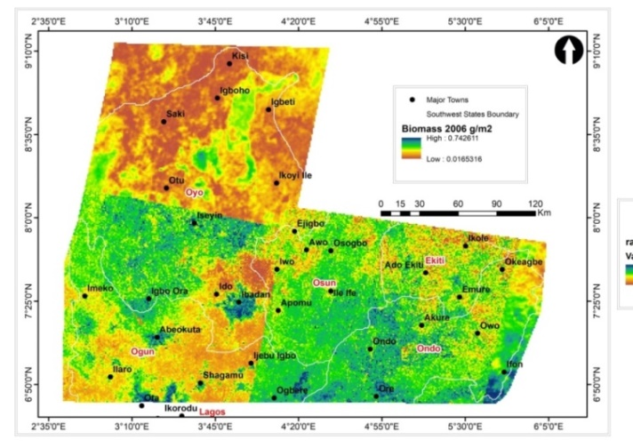
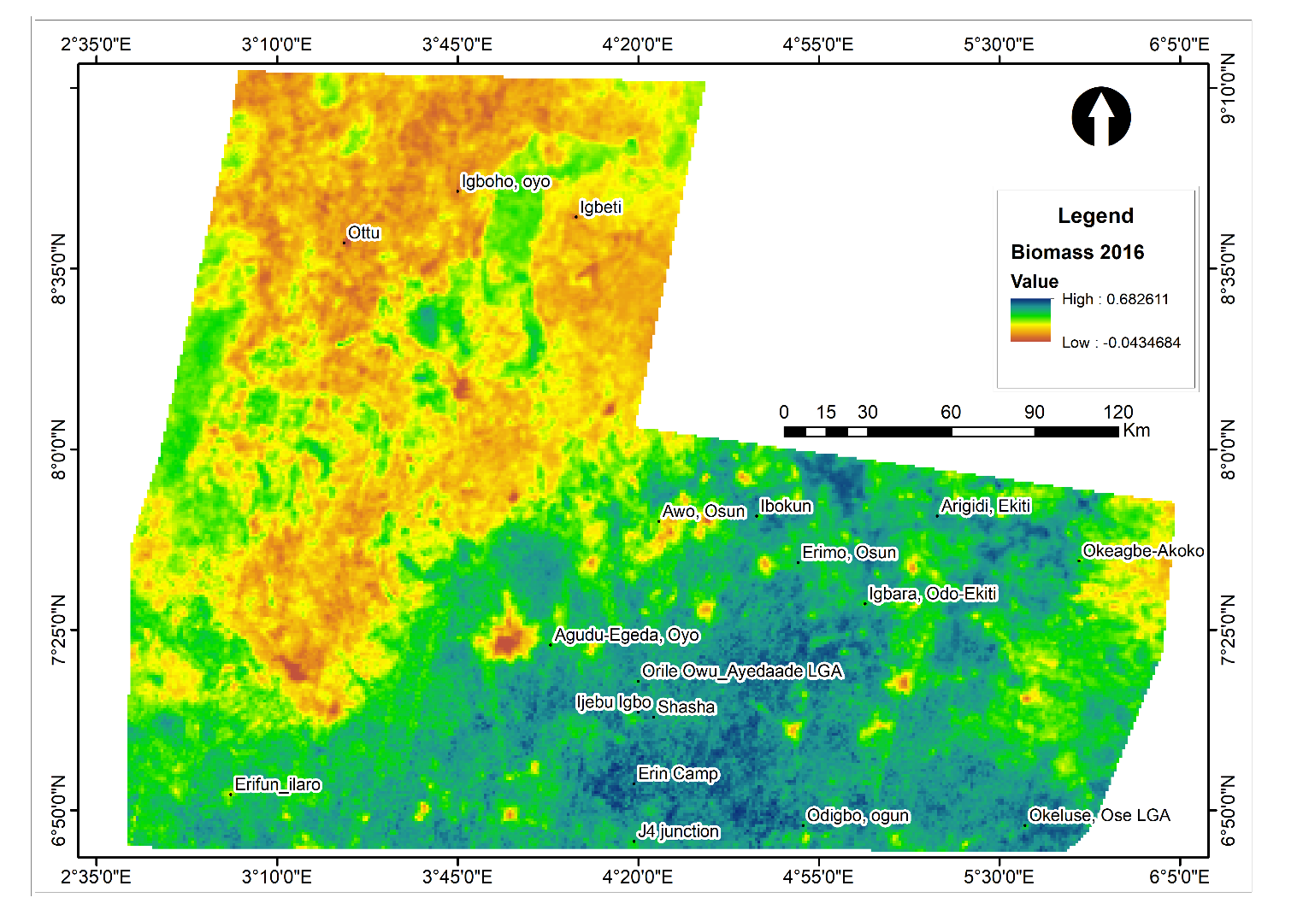
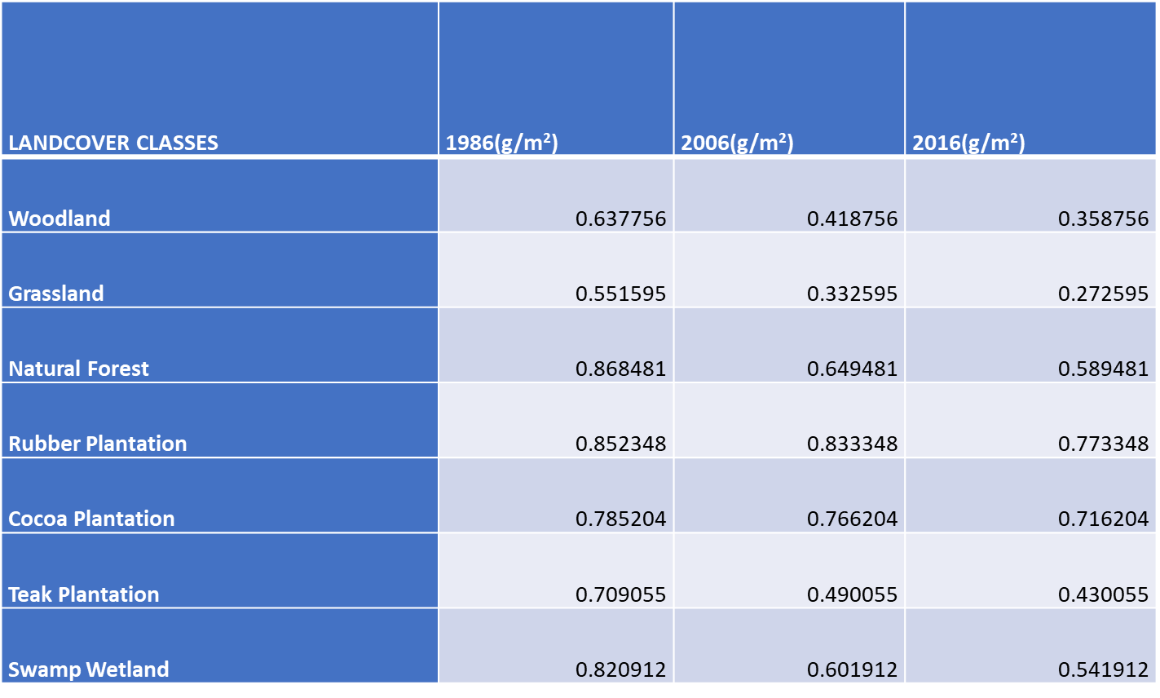
Biomass change pattern across the study area
1986
2006
1986
2006
2016

Slide 22
OBJECTIVE 3 - Carbon Fluxes in the Forest and Woodland areas between 1986 and 2016

Slide 23
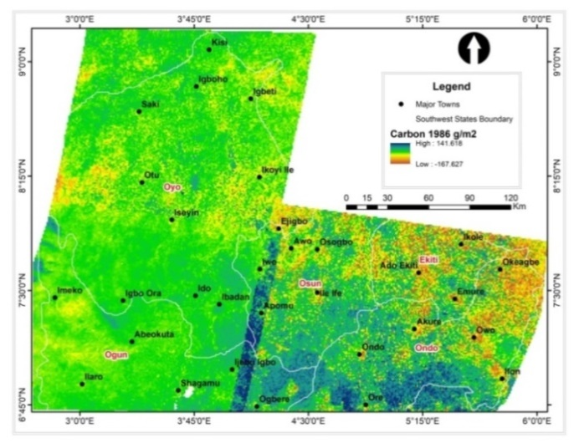
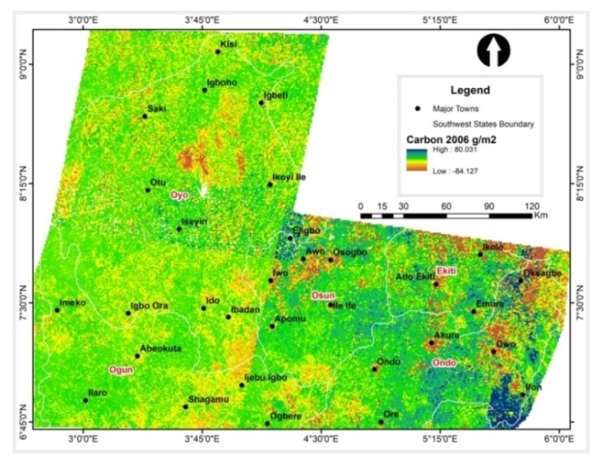
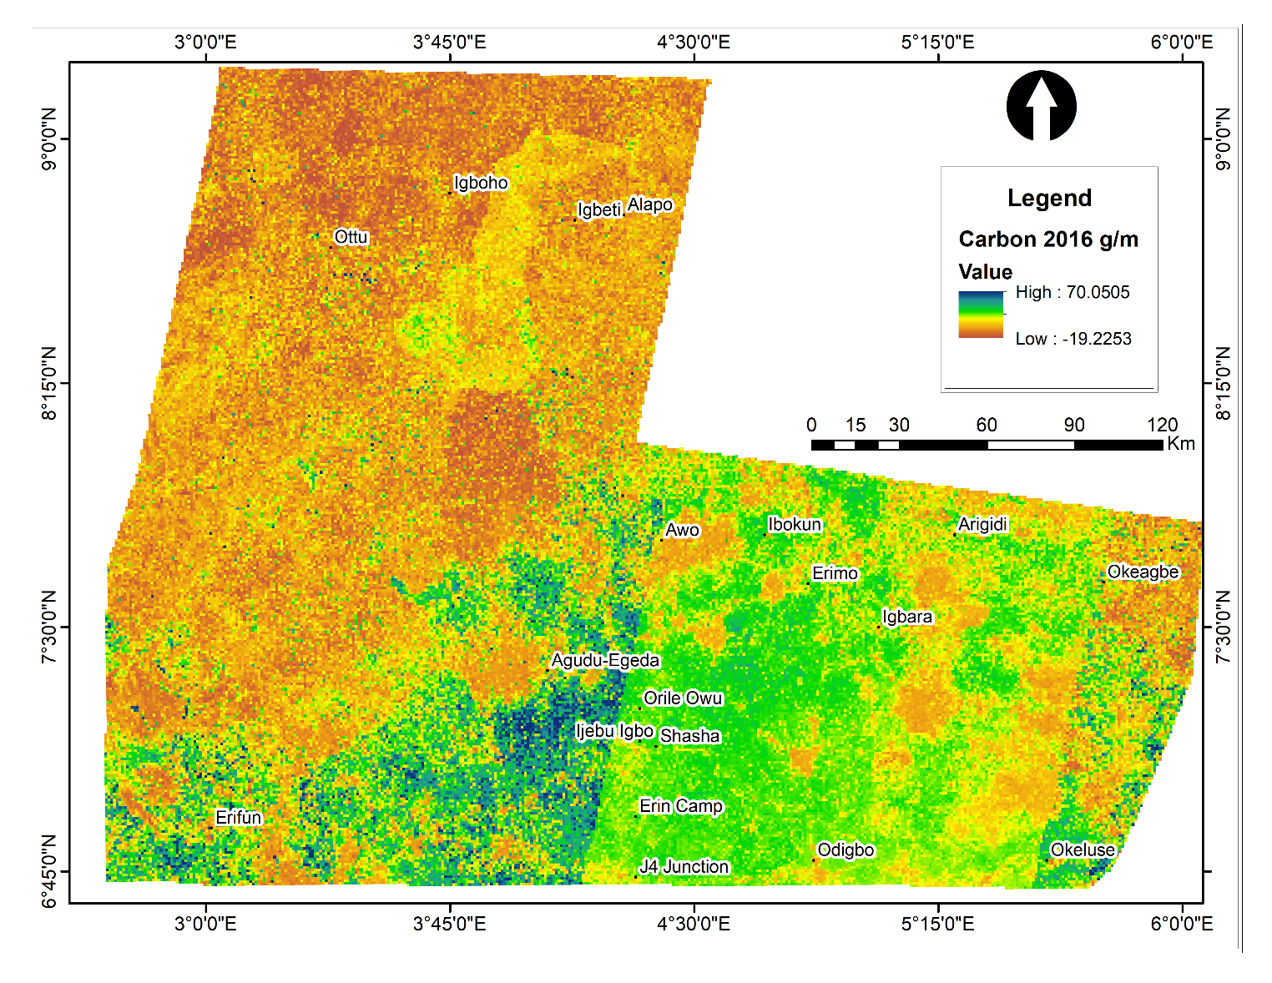
Carbon stock fluxes across the study area
1986
2006
2016

Slide 24
Field Measured Carbon Estimation
Plot/ Location | Plot Dimension | Liter Biomass (g/m²) | Herb Biomass (g/m²) | Tree Biomass (g/m²) | AGB (gram/m²) | AGB (tons/ha) | AGC (Mg C) | AGC (Mg C/ha)
Woodland – Erifun | 25mX25m | 37.3 | 28.27 | 25648.26 | 25713.83 | 283.45 | 141.72 | 128.57
Woodland – Awo | 25mX25m | 47.35 | 124.38 | 9368.64 | 9540.37 | 105.16 | 52.58 | 47.70
Woodland - Igboho, | 25mX25m | 134.46 | 101 | 37013.69 | 37249.15 | 410.60 | 205.30 | 186.25
Woodland - Okeagbe-Akoko | 25mX25m | 39.95 | 14.31 | 46125.12 | 46179.38 | 509.04 | 254.52 | 230.90
Woodland-Ikoyi Ile | 25mX25m | 80.46 | 18.33 | 22680.27 | 22779.06 | 251.10 | 125.55 | 113.90
Woodland – Ottu | 25mX25m | 141.58 | 1.02 | 26121.93 | 26264.53 | 289.52 | 144.76 | 131.32
Natural Forest - Orile Owu | 25mX25m | 80.54 | 31.47 | 16465.06 | 16577.07 | 182.73 | 91.37 | 82.89
Natural Forest- Okeluse | 25mX25m | 70.6 | 3.93 | 170412.90 | 170487.43 | 1879.30 | 939.65 | 852.44
Natural Forest – Shasha | 25mX25m | 51.02 | 44.52 | 16798.40 | 16893.94 | 186.22 | 93.11 | 84.47
Natural Forest - Erin Camp | 25mX25m | 95.62 | 45.82 | 525153.61 | 525295.05 | 5790.38 | 2895.19 | 2626.47
Cocoa Plantation – Igbara Oke | 25mX25m | 111.09 | 22.2 | 136729.82 | 136863.11 | 1508.66 | 754.33 | 684.31
Cocoa Plantation – Ibokun | 25mX25m | 56.41 | 49.91 | 25651.86 | 25758.18 | 283.94 | 141.97 | 128.79
Cocoa Plantation – Ijebu Ijesha | 25mX25m | 94.46 | 45.39 | 42187.84 | 42327.69 | 466.58 | 233.29 | 211.64
Grassland – Igbeti | 25mX25m | 50.5 | 44 | 3299.87 | 3394.37 | 37.42 | 18.71 | 16.97
Grassland – Odo Ayedun | 25mX25m | 90.21 | 125.86 | 21165.56 | 21381.63 | 235.69 | 117.85 | 106.91
Oil Plam – Ijebu Igbo | 25mX25m | 102.3 | 95.8 | 33705.75 | 33903.85 | 373.73 | 186.86 | 169.52
Gmelina – Odigbo | 25mX25m | 102 | 45.64 | 29211.80 | 29359.44 | 323.63 | 161.82 | 146.80
Teak Plantation - J4 junction | 25mX25m | 42.95 | 39.1 | 48338.14 | 48420.19 | 533.74 | 266.87 | 242.10

Slide 25
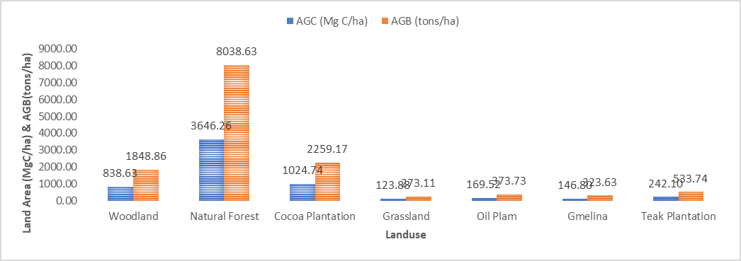
Carbon Across Land Use In The Study Area

Slide 26
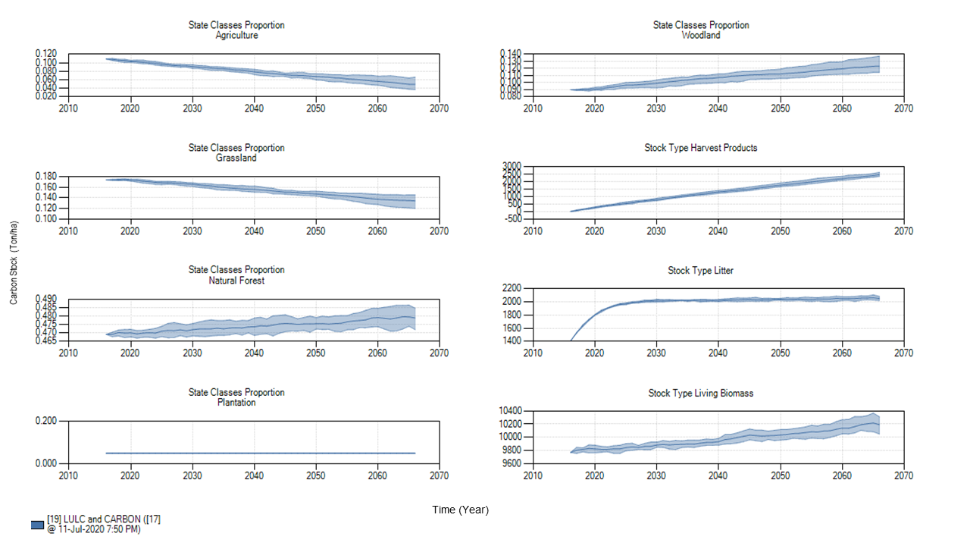
OBJECTIVE 4 - Carbon Stock Projection

Slide 27
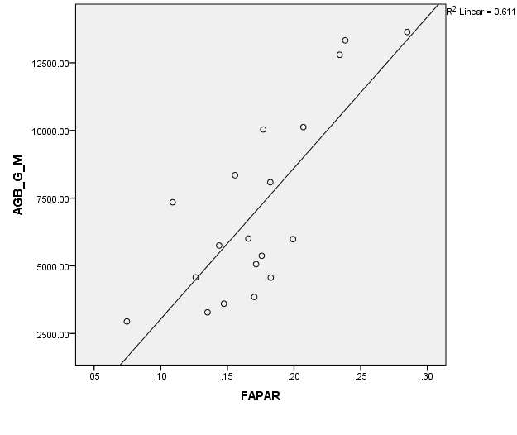
Model Validation: Agreement between Remote Sensing Carbon and Field Measured Carbon
File Measurement
Remote Sensing Estimation

Slide 28
Summary of findings
From 1986 through 2006 to 2016, woodland area had a total change of 27.79%, and the forest area lost 12.75%.
The Biomass trends for 30 years decreased from 141g/m² in 1986 to 70 g/m² in 2016.
Carbon Simulation shows that natural forest had 34,829.74 tons/ha, followed by cocoa plantation with a recorded total carbon stock of 21,674.0 tons/ha.
Carbon stock projection reveals a decline from 20 tons/ha in 2016 to 8 tons/ha in 2066 within the study area.

Slide 29
Conclusion
The Research has shown that deforestation is high and has been consistent throughout the study period.
The natural forest is declining in extent and quality, giving way to woodland.
The projected Above Ground carbon stock for 2066 shows a reduction in other land uses but a slight increase in natural forests.
Hence, there is a need to increase the rate of carbon sequestration through afforestation.

Slide 30
Recommendations
There is a need to establish a well-structured land-use/landcover change inventory in the study area.
The Forest Wood Product (FWP) extraction policy should be strengthened to check the uncoordinated lumbering, leading to forest degradation.
The government should review the national policy on tree replacement to maintain the rate of carbon sink.
The forest biomass future projection should be carried out from time to time to enhance proper forest carbon sink tracking and accountability.
There is need to adopt remote sensing technique in order to ease the estimation of above ground carbon potential of the entire country over space and time.

Slide 31
Contribution to Knowledge
The study created an inventory on the magnitude and rate of land use/landcover change in Southwest Nigeria between 1986 and 2016.
The research established baseline information on aboveground biomass and carbon stocks in the natural forest and woodland areas of SW Nigeria.
The study established the historical and future pattern and distribution of carbon stock in SW Nigeria.
This research creates a good baseline data for the newly constituted Council on Climate Change in Nigeria.

Slide 32
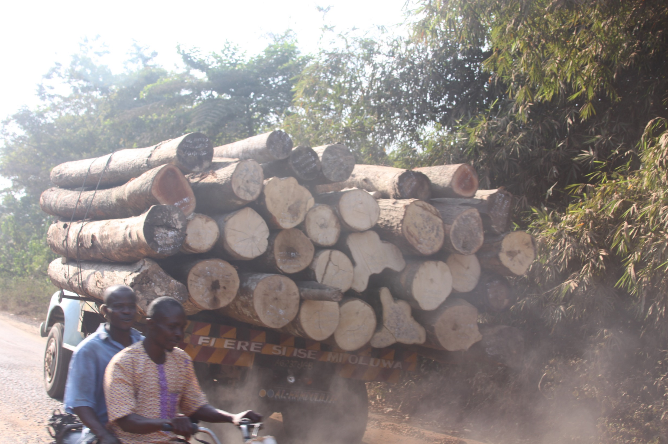
Thank you

